Slide 1
Introduction to GitOps
Weaveworks – https://weave.works – @weaveworks

Slide 2

Unless specified, these slides are © Weaveworks 2019.
They are made available under a Creative Common License.
Attribution-NonCommercial-ShareAlike 4.0 International (CC BY-NC-SA 4.0)
You can attribute in the following way:
“Created by Weaveworks / Derived from material created by Weaveworks.
Original available at https://tinyurl.com/introduction-to-gitops”

Slide 3
Introduction to GitOps

Slide 4
GitOps is...

Slide 5
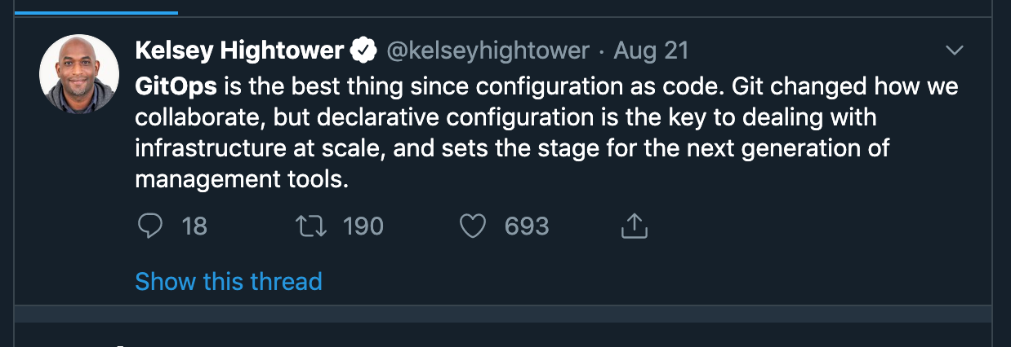

Slide 6
GitOps is...
An operation model

Slide 7
GitOps is...
An operation model
Derived from CS and operation knowledge

Slide 8
GitOps is...
An operation model
Derived from CS and operational knowledge
Technology agnostic (name notwithstanding)

Slide 9
GitOps is...
An operation model
Derived from CS and operational knowledge
Technology agnostic (name notwithstanding)
A set of principles (Why instead of How)

Slide 10

GitOps is...
An operation model
Derived from CS and operational knowledge
Technology agnostic (name notwithstanding)
A set of principles (Why instead of How)
Although Weaveworks can help
with how

Slide 11
GitOps is...
An operation model
Derived from CS and operational knowledge
Technology agnostic (name notwithstanding)
A set of principles (Why instead of How)
A way to speed up your team

Slide 12
The GitOps Model

Slide 13
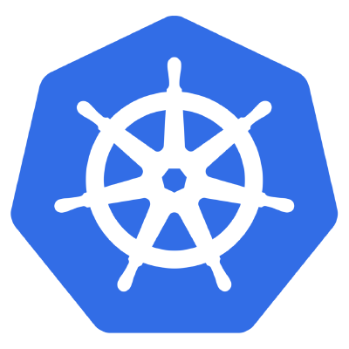
GitOps ON Kubernetes
Kubernetes Cluster

Slide 14

GitOps ON Kubernetes
Kubectl / Direct access

Slide 15
GitOps ON Kubernetes

Slide 16

GitOps ON Kubernetes
Configuration
Repository

Slide 17
GitOps ON Kubernetes

Slide 18
GitOps ON Kubernetes
Deployment Agent *

Slide 19
*
Security Boundary

Slide 20
GitOps ON Kubernetes

Slide 21
GitOps ON Kubernetes
Image
Repository

Slide 22
GitOps ON Kubernetes
State continuously monitored

Slide 23
GitOps ON Kubernetes
Control Loop

Slide 24
Principles of GitOps

Slide 25
1
The entire system is described declaratively.
2
The canonical desired system state is versioned
(with Git)
Approved changes to the desired state are
automatically applied to the system
3
4
Software agents ensure correctness
and alert on divergence

Slide 26
1
The entire system is described declaratively.

Slide 27
1
The entire system is described declaratively.
Beyond code, data ⇒
Implementation independent
Easy to abstract in simple ways
Easy to validate for correctness
Easy to generate & manipulate from code

Slide 28
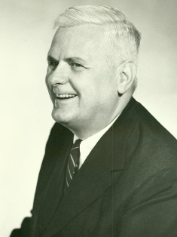
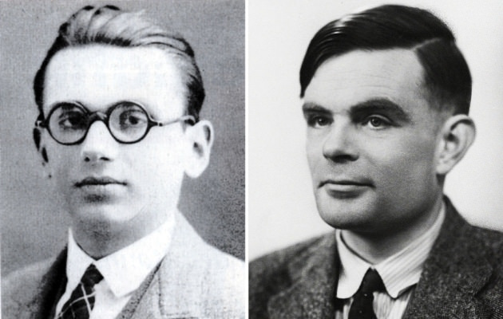
1
The entire system is described declaratively.
Beyond code, data ⇒
Implementation independent
Easy to abstract in simple ways
Easy to validate for correctness
Easy to generate & manipulate from code

Slide 29
How is that different from Infrastructure as code?

Slide 30
How is that different from Infrastructure as code?
It’s about consistency in the failure case.

Slide 31
What’s wrong with code and imperative configuration?
It’s about consistency in the failure case.
When imperative systems fail, the system ends up in an unknown, inconsistent state.

Slide 32
When imperative systems fail, the system ends up in an unknown, inconsistent state.
Declarative changes let you think of changes as transactions.

Slide 33
Declarative changes let you think of changes as transactions.
This is a very good thing.

Slide 34
2
The canonical desired system state is versioned
(with Git)

Slide 35
2
The canonical desired system state is versioned
(with Git)
Canonical Source of Truth (DRY)
With declarative definition, trivialises rollbacks
Excellent security guarantees for auditing
Sophisticated approval processes (& existing workflows)
Great Software ↔ Human collaboration point

Slide 36
3
Changes to the desired state are
automatically applied to the system

Slide 37
3
Approved changes to the desired state are
automatically applied to the system
Significant velocity gains
Privileged operators don’t cross security boundaries
Separates What and How.

Slide 38
4
Software agents ensure correctness
and alert on divergence

Slide 39
4
Software agents ensure correctness
and alert on divergence
Continuously checking that desired state is met
System can self heal
Recovers from errors without intervention (PEBKAC/PICNIC)
It’s the control loop for your operations

Slide 40
GitOps ON Kubernetes
1
Image
Repository
The entire system is described declaratively.

Slide 41
GitOps ON Kubernetes
2
Image
Repository
The desired system state is versioned

Slide 42
GitOps ON Kubernetes
3
Image
Repository
Approved changes to the desired state are
automatically applied to the system

Slide 43
GitOps ON Kubernetes
4
Software agents ensure correctness
and alert on divergence
Image
Repository

Slide 44
Gitops is Functional Reactive Programming…
...for your infrastructure.
Like React, but for servers and applications.

Slide 45
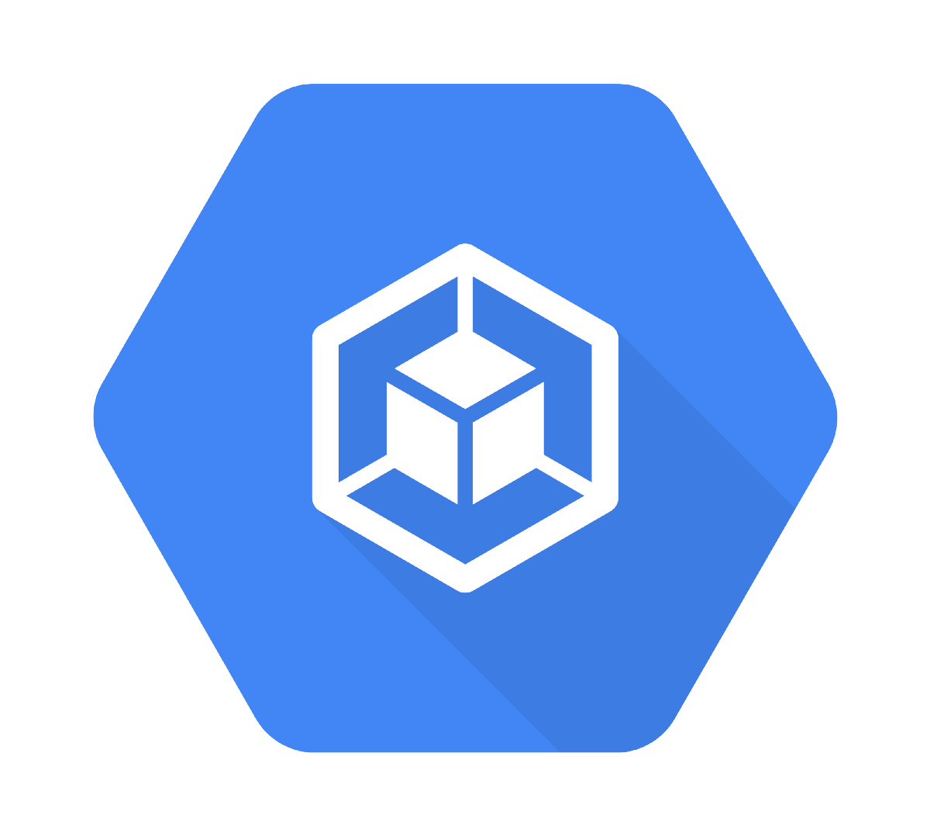

Typical CICD pipeline
Shares credentials cross several logical security boundaries.
Git creds
CI creds
CR creds²
CR creds³
Cluster API
Dev
Code Repo
CI
Container Registry
RO
RW
RO
RW
RW
RW
CR creds¹
API creds
Continuous Integration
Boundary
Continuous Delivery/Deployment
Notes:
Boundary could be internet, or a logical security context
Each logical security context boundary enables defence in depth, unless credentials cross multiple boundaries
Developers shouldn’t push images direct to image registry
Cluster API is exposed to a lower security context
Cluster credentials are present in a lower security context
Developer and CI system becomes a high value targets, because they have write credentials for systems
No record of the desired/expected state of the cluster

Slide 46
GitOps pipeline
Credentials are never shared across a logical security boundary.
Git creds
CI creds
CR creds²
CR creds³
Cluster API
Dev
Code Repo
CI
Container Registry
Cluster API creds
RW
RO
RW
RW
RO
Deploy
RO
RW
CR creds¹
Config repo creds
Canonical desired
state store
Config Repo
Notes:
Boundaries could be internet, or a logical security context
Separation of concerns
Each logical security context boundary enables defence in depth
Credentials limit access to services inside each logical security context boundary
Developers can’t push directly to image registry
Cluster API & credentials are never exposed/cross boundary
Deploy agent retains credentials inside cluster
Separate config repo, independent source of truth of desired state of cluster

Slide 47

GitOps pipeline
Credentials are never shared across a logical security boundary.
Git creds
CI creds
CR creds²
CR creds³
Cluster API
Dev
Code Repo
CI
Container Registry
Cluster API creds
RW
RO
RW
RW
RO
Deploy
RO
RW
CR creds¹
Config repo creds
Operator
Config Repo
RW
Notes:
Boundaries could be internet, or a logical security context
Separation of concerns
Each logical security context boundary enables defence in depth
Credentials limit access to services inside each logical security context boundary
Developers can’t push directly to image registry
Cluster API & credentials are never exposed/cross boundary
Deploy agent retains credentials inside cluster
Separate config repo, independent source of truth of desired state of cluster

Slide 48

GitOps pipeline
Credentials are never shared across a logical security boundary.
Git creds
CI creds
CR creds²
CR creds³
Cluster API
Dev
Code Repo
CI
Container Registry
Cluster API creds
RW
RO
RW
RW
RO
Deploy
RO
RW
CR creds¹
Config repo creds
Operator
Config Repo
RW
Process & constraints
enforcement
Notes:
Boundaries could be internet, or a logical security context
Separation of concerns
Each logical security context boundary enables defence in depth
Credentials limit access to services inside each logical security context boundary
Developers can’t push directly to image registry
Cluster API & credentials are never exposed/cross boundary
Deploy agent retains credentials inside cluster
Separate config repo, independent source of truth of desired state of cluster

Slide 49
GitOps pipeline
Credentials are never shared across a logical security boundary.
Git creds
CI creds
CR creds²
CR creds³
Cluster API
Dev
Code Repo
CI
Container Registry
Cluster API creds
RW
RO
RW
RW
RO
Deploy
RO
RW
CR creds¹
Config repo creds
Operator
Config Repo
RW
Exceptional auditing
and attribution*
Notes:
Boundaries could be internet, or a logical security context
Separation of concerns
Each logical security context boundary enables defence in depth
Credentials limit access to services inside each logical security context boundary
Developers can’t push directly to image registry
Cluster API & credentials are never exposed/cross boundary
Deploy agent retains credentials inside cluster
Separate config repo, independent source of truth of desired state of cluster

Slide 50
What should be GitOps’ed?

Slide 51

What should be GitOps’ed?
I’m so very sorry

Slide 52
?

Slide 53
Kubernetes Manifests
Application configuration
Provisioning config
Dashboards
Alerts
Operator Runbooks
Application checklists
Monitoring Data Pipeline
Sealed Secrets

Slide 54


Slide 55
Why should we care?
Trivialises rollbacks
Exceptional auditing and attribution*
Separation of concerns
No crossing security boundary
Process & constraints enforcement
Great Software ↔ Human collaboration point
Easy to validate for correctness (Policies)
System can self heal

Slide 56
Why should we care?
Trivialises rollbacks
Exceptional auditing and attribution*
Separation of concerns
No crossing security boundary
Process & constraints enforcement
Great Software ↔ Human collaboration point
Easy to validate for correctness (Policies)
System can self heal
* If you’ve secured your Git repositories properly

Slide 57
GitOps at Weaveworks

Slide 58
Gated, PR-driven changes to production
Read-only access to production
for all developers
Dashboard definitions in Git (Grafanalib, Open Source)
Alert definitions in git
Some of the GitOps things we do
Automated diff tools
(*diff operators, Open Source)
Promotion from staging to prod
CD into staging
Multiple clusters (staging and prod)
Kubernetes operator (Flux, Open Source)
Kubernetes
*“stress-reduced”

Slide 59
Gated, PR-driven changes to production
Read-only access to production
for all developers
Dashboard definitions in Git (Grafanalib, Open Source)
Alert definitions in git
Automated diff tools
(*diff operators, Open Source)
Promotion from staging to prod
CD into staging
Multiple clusters (staging and prod)
Kubernetes operator (Flux, Open Source)
Kubernetes
*“stress-reduced”

Slide 60
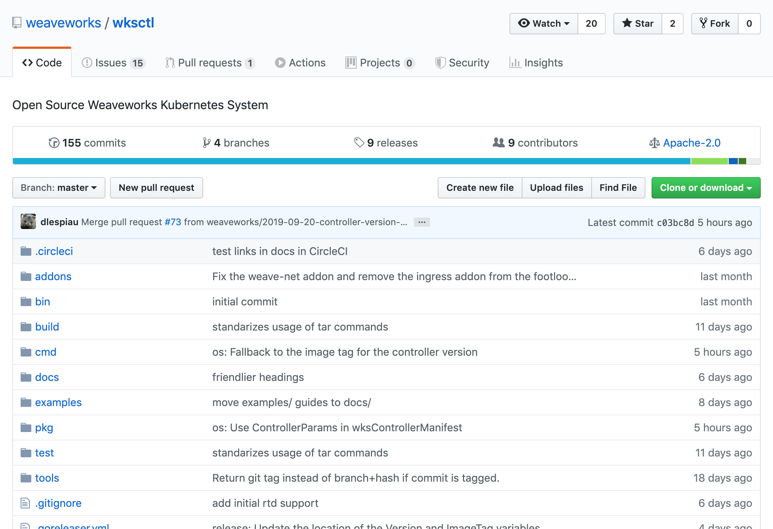
https://github.com/weaveworks/wksctl

Slide 61

Deploying Kubernetes the
GitOps way

Slide 62
Gated, PR-driven changes to production
Read-only access to production
for all developers
Dashboard definitions in Git (Grafanalib, Open Source)
Alert definitions in git
Automated diff tools
(*diff operators, Open Source)
Promotion from staging to prod
CD into staging
Multiple clusters (staging and prod)
Kubernetes operator (Flux, Open Source)
Kubernetes
*“stress-reduced”

Slide 63

https://fluxcd.io

Slide 64
Deploying a service with Flux

Slide 65
Gated, PR-driven changes to production
Read-only access to production
for all developers
Dashboard definitions in Git (Grafanalib, Open Source)
Alert definitions in git
Automated diff tools
(*diff operators, Open Source)
Promotion from staging to prod
CD into staging
Multiple clusters (staging and prod)
Kubernetes operator (Flux, Open Source)
Kubernetes
*“stress-reduced”

Slide 66
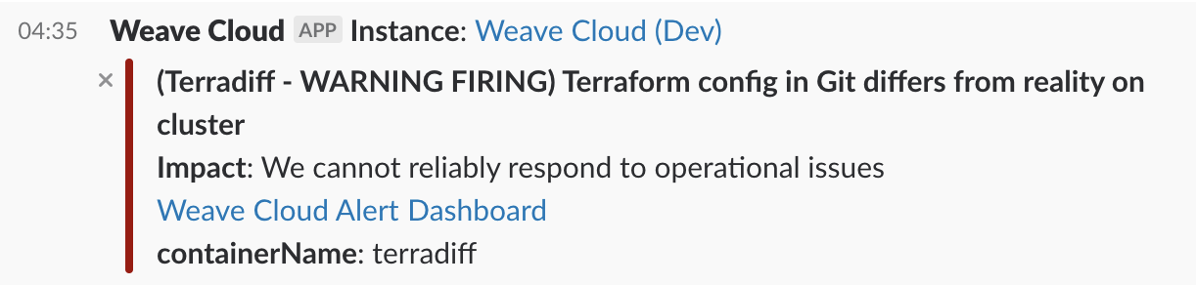

Slide 67
Gated, PR-driven changes to production
Read-only access to production
for all developers
Dashboard definitions in Git (Grafanalib, Open Source)
Alert definitions in git
Automated diff tools
(*diff operators, Open Source)
Promotion from staging to prod
CD into staging
Multiple clusters (staging and prod)
Kubernetes operator (Flux, Open Source)
Kubernetes
*“stress-reduced”

Slide 68
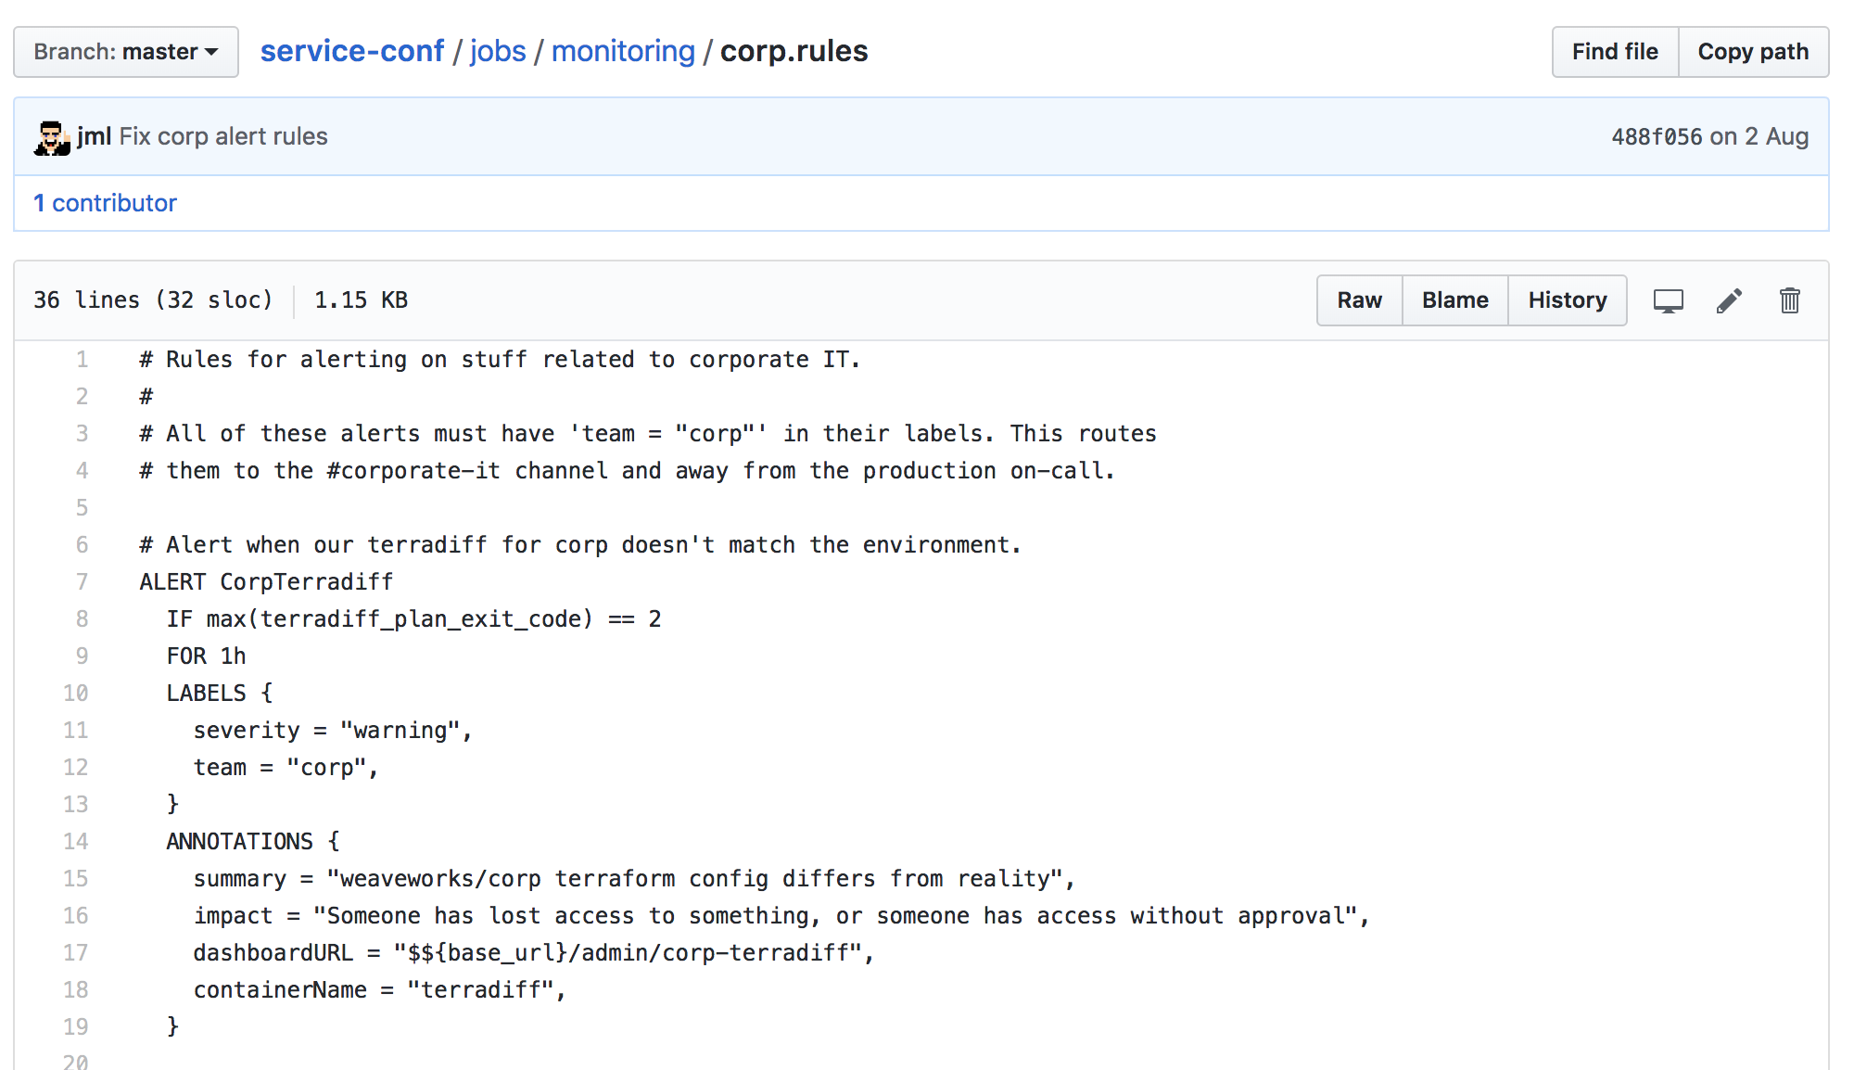

Slide 69
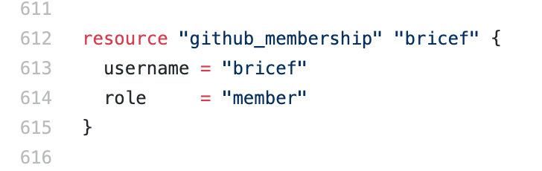
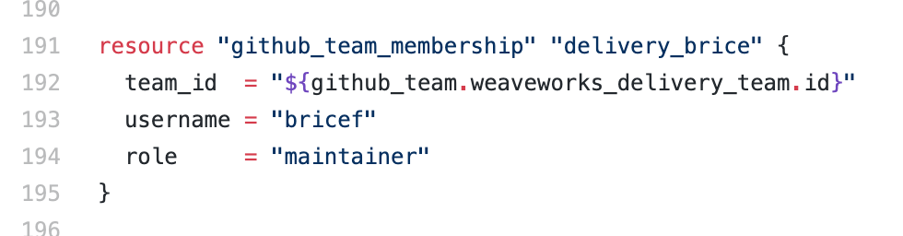

Slide 70
Gated, PR-driven changes to production
Read-only access to production
for all developers
Dashboard definitions in Git (Grafanalib, Open Source)
Alert definitions in git
Automated diff tools
(*diff operators, Open Source)
Promotion from staging to prod
CD into staging
Multiple clusters (staging and prod)
Kubernetes operator (Flux, Open Source)
Kubernetes
*“stress-reduced”

Slide 71
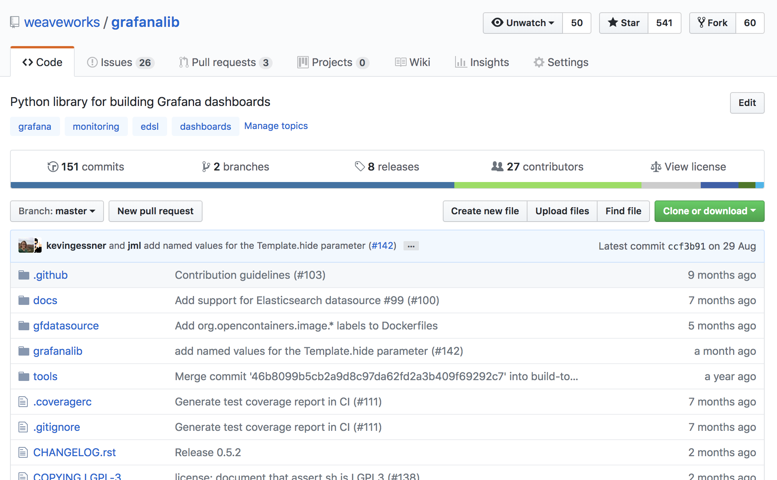

Slide 72
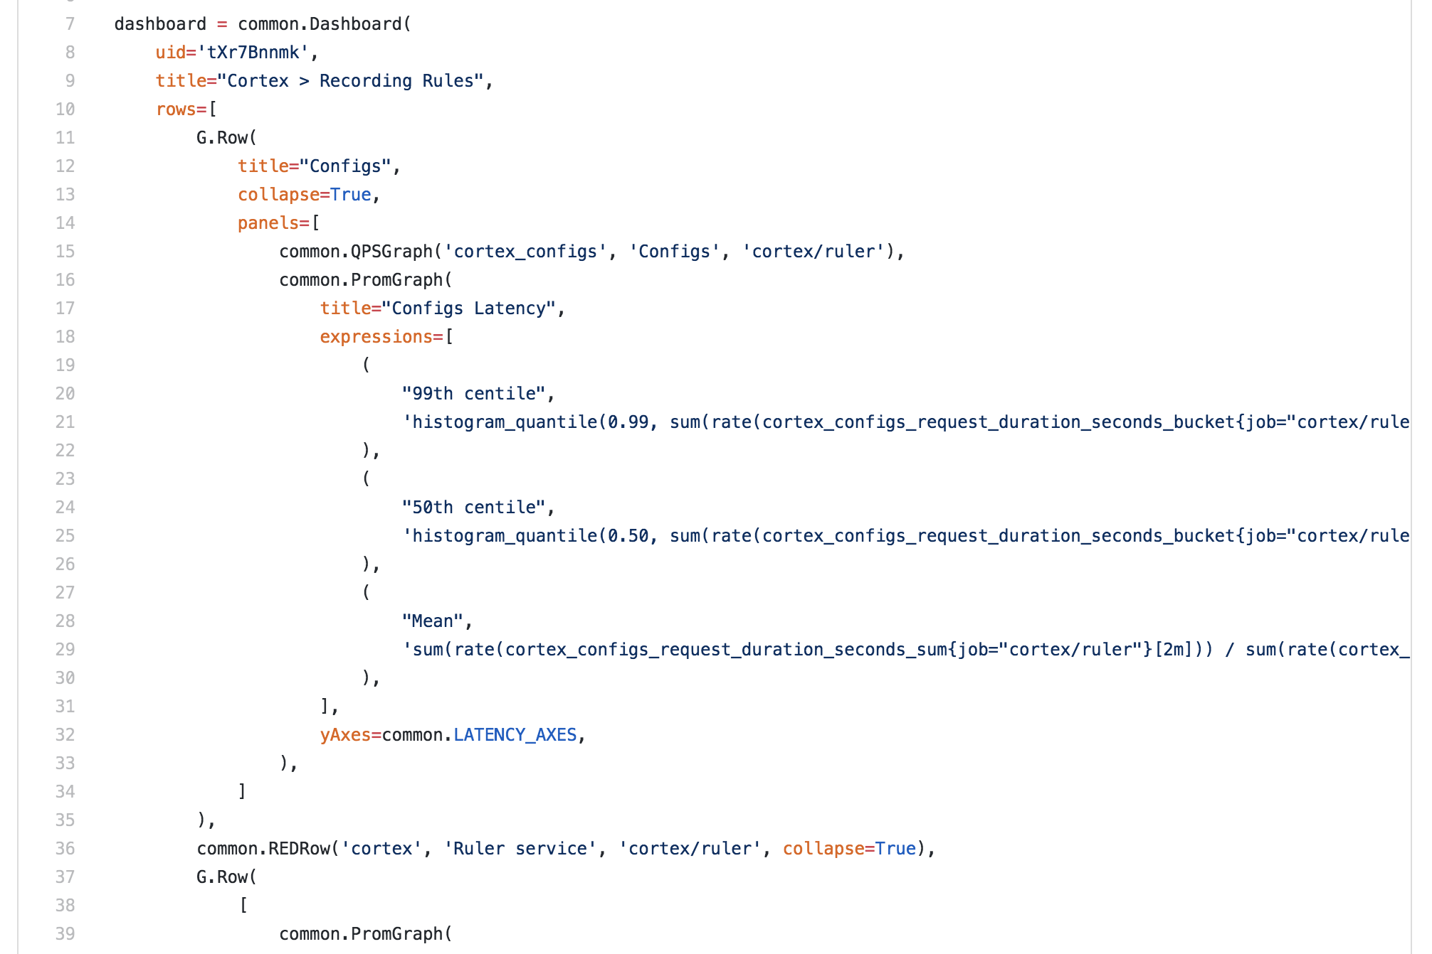

Slide 74
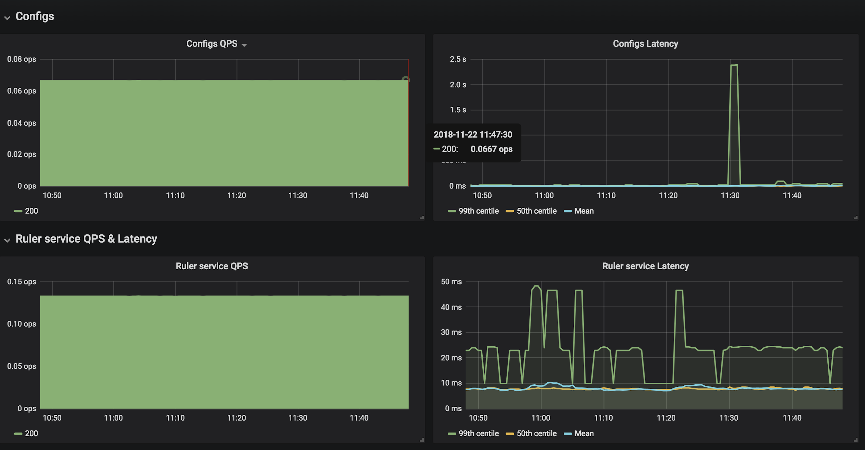

Slide 77
Gated, PR-driven changes to production
Read-only access to production
for all developers
Dashboard definitions in Git (Grafanalib, Open Source)
Alert definitions in git
⇒
Automated diff tools
(*diff operators, Open Source)
Promotion from staging to prod
CD into staging
Multiple clusters (staging and prod)
Kubernetes operator (Flux, Open Source)
Kubernetes
*“stress-reduced”

Slide 78
Gated, PR-driven changes to production
< 30 minute total disaster recovery
Read-only access to production
for all developers
Dashboard definitions in Git (Grafanalib, Open Source)
Alert definitions in git
⇒
Automated diff tools
(*diff operators, Open Source)
Promotion from staging to prod
CD into staging
Multiple clusters (staging and prod)
Kubernetes operator (Flux, Open Source)
Kubernetes

Slide 79
Gated, PR-driven changes to production
< 30 minute total disaster recovery
Dozens of changes per day
with a very small team
Read-only access to production
for all developers
Dashboard definitions in Git (Grafanalib, Open Source)
Alert definitions in git
⇒
Automated diff tools
(*diff operators, Open Source)
Promotion from staging to prod
CD into staging
Multiple clusters (staging and prod)
Kubernetes operator (Flux, Open Source)
Kubernetes

Slide 80
Gated, PR-driven changes to production
< 30 minute total disaster recovery
Dozens of changes per day
with a very small team
Incredibly fast
regression response
Read-only access to production
for all developers
Dashboard definitions in Git (Grafanalib, Open Source)
Alert definitions in git
⇒
Automated diff tools
(*diff operators, Open Source)
Promotion from staging to prod
CD into staging
Multiple clusters (staging and prod)
Kubernetes operator (Flux, Open Source)
Kubernetes

Slide 81
Gated, PR-driven changes to production
< 30 minute total disaster recovery
Dozens of changes per day
with a very small team
Incredibly fast
regression response
Permissive approach
to production access
Read-only access to production
for all developers
Dashboard definitions in Git (Grafanalib, Open Source)
Alert definitions in git
⇒
Automated diff tools
(*diff operators, Open Source)
Promotion from staging to prod
CD into staging
Multiple clusters (staging and prod)
Kubernetes operator (Flux, Open Source)
Kubernetes

Slide 82
Gated, PR-driven changes to production
< 30 minute total disaster recovery
Dozens of changes per day
with a very small team
Incredibly fast
regression response
Permissive approach
to production access
Excellent developer experience
Read-only access to production
for all developers
Dashboard definitions in Git (Grafanalib, Open Source)
Alert definitions in git
⇒
Automated diff tools
(*diff operators, Open Source)
Promotion from staging to prod
CD into staging
Multiple clusters (staging and prod)
Kubernetes operator (Flux, Open Source)
Kubernetes

Slide 83
Gated, PR-driven changes to production
< 30 minute total disaster recovery
Dozens of changes per day
with a very small team
Incredibly fast
regression response
Permissive approach
to production access
Excellent developer experience
Stress-free on-call*
Read-only access to production
for all developers
Dashboard definitions in Git (Grafanalib, Open Source)
Alert definitions in git
⇒
Automated diff tools
(*diff operators, Open Source)
Promotion from staging to prod
CD into staging
Multiple clusters (staging and prod)
Kubernetes operator (Flux, Open Source)
Kubernetes

Slide 84
Gated, PR-driven changes to production
< 30 minute total disaster recovery
Dozens of changes per day
with a very small team
Incredibly fast
regression response
Permissive approach
to production access
Excellent developer experience
Stress-free on-call*
Read-only access to production
for all developers
Dashboard definitions in Git (Grafanalib, Open Source)
Alert definitions in git
⇒
Automated diff tools
(*diff operators, Open Source)
Promotion from staging to prod
CD into staging
Multiple clusters (staging and prod)
Kubernetes operator (Flux, Open Source)
Kubernetes
*“stress-reduced”

